Slide 1

A Web-based Document Summarizing And Topic Prediction System Using Natural Language Processing
Presentation On:
Supervised by: Dr. Adigun Taiwo

Slide 2
Project By:
Ebereonwu Einstein Munachiso – 19/0512
Shoyemi Olasubomi Tutuloro – 19/1167
Udo David David – 19/1326

Slide 3

Scan QR to Access System

Slide 4
Introduction.
With the increasing amount of information being generated through technology and the need for quick information processing, extracting the key information embedded in large body of text has become almost unachievable for individuals from various backgrounds such as education, medicine, tourism, law, and many more.
However, because of technological advancements and the existence of Artificial Intelligence (AI), with a focus on Natural Language Processing (NLP), the work of summarizing has become a very seamless task; systems such as this are now very capable of churning large bodies of text while also withholding the semantics.

Slide 5
Statement of the Problem
The vastness of the information available online has brought about several pros and cons, some of which this research wishes to address. Some of the problems which the advancement of technology and influx in information has lead to the following problems:
The issue of topic identification.
The issue of key point filtering in large bodies of text.

Slide 6
Aim and Objectives.
AIM:
To develop and implement a web-based document summarization and topic prediction system using natural language processing which is able to summarize text, predict topic, convert text summary to speech.
OBJECTIVES:
To develop and implement a text summarizing, language detection model.
To Integrate the text summarizing and language detection model
To conduct an evaluation of the proposed system.

Slide 7
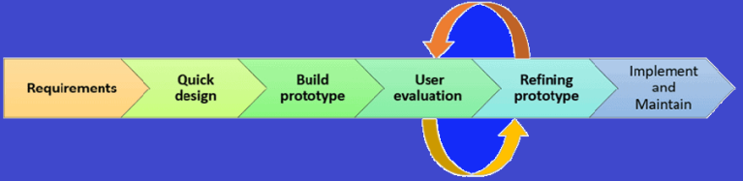
Methodology.
Process Model
For the purpose of this project, the prototyping model will be adopted.
The Prototyping Model is a Systems Development Methodology that constructs, tests, and then reworks an ideal output or an early estimation of a final system or product. It is repeated until an appropriate standard is obtained to aid in the development of the entire system or product. (Lewis, 2019)
Figure by (Martin, 2020) in article “Prototype Model in Software Engineering”

Slide 8
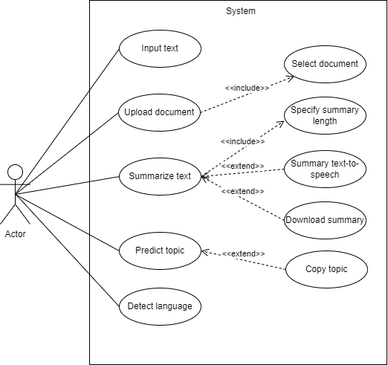
Methodology.
Use Case Diagram
The Use Case diagram models each interaction a user can perform with the system.

Slide 9
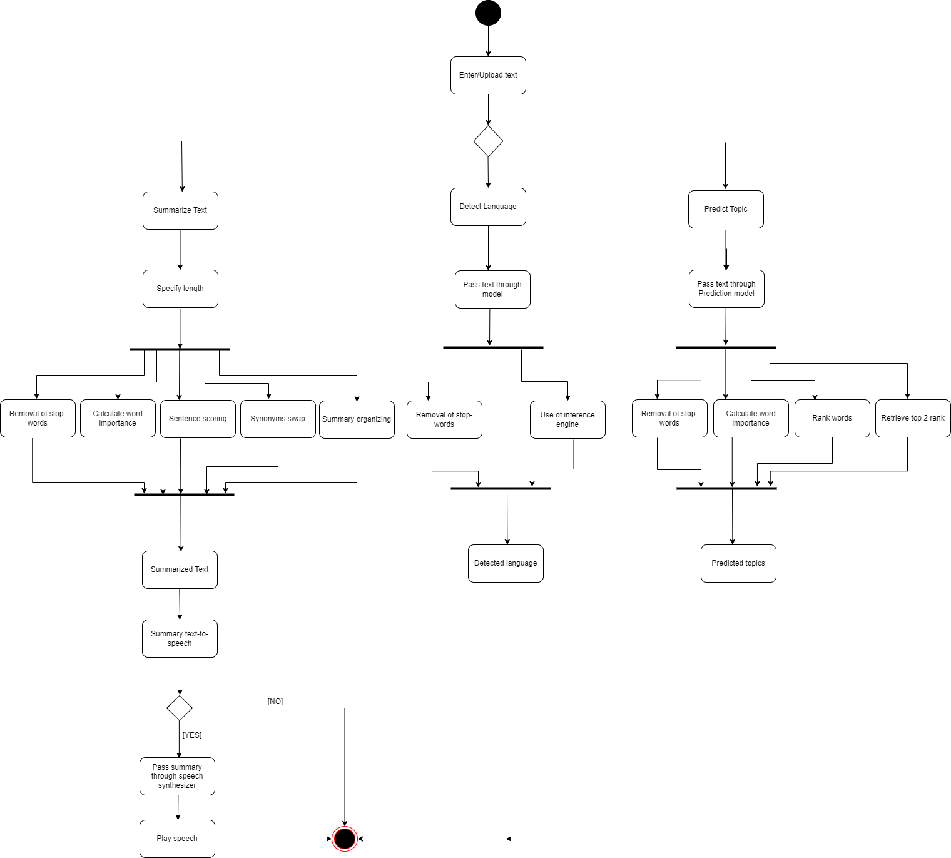
Methodology.
Activity Diagram
The Activity diagram models the software process in progressive order of actions.

Slide 10
Methodology.
Design/Implementation Tools
The design/implementation tools for this system include:
Microsoft Visual Studio Code: Integrated Development Environment.
Sci-kit Learn: Python Machine Learning library (Lng. detection)
NLTK: Python Natural language processing library (Topic pred. & Summary)
Flask: Python Back-end library/Framework
HTML: Front-end structure definition.
CSS: Front-end structure design.
JavaScript: Front-end dynamic content management.
Figma: UI/UX design

Slide 11
Significance of the Study
The study focuses on developing an intelligent system that is able to quickly produce:
un-biased summaries
un-ambiguous summaries and relevant summaries
Predict the topic from of body of text.
Detect language based on content.
Text-to-speech to increase system usability especially for the blind.

Slide 12
Review of Related Works.
S/N | AUTHOR & YEAR | NAME | METHODOLOGY | FEATURES | STRENGTH | WEAKNESS
1 | (Xu, Jiang & Lau, 2009). | USER-ORIENTED DOCUMENT SUMMARIZATION THROUGH VISION-BASED EYE-TRACKING | word semantics analysis, vision-based commodity eye-tracking | Document summarizing through user attention. | It is capable of determining word importance based on user attention. | It relies heavily on user attention
2 | (Ashari & Riasetiawan, 2017). | DOCUMENT SUMMARIZATION USING TEXTRANK AND SEMANTIC NETWORK | Text rank algorithm, Semantic Networks, Corpus Statistics | Semantic networks for drawing out relationships and text rank algorithm draw out important texts. | Semantic networks are able to efficiently identify relationships between texts. | The quality of the summaries are influenced by the style of writing

Slide 13
Review of Related Works.
S/N | AUTHOR & YEAR | NAME | METHODOLOGY | FEATURES | STRENGTH | WEAKNESS
3 | (Anjali, Meera, Thushara, 2019) | A GRAPH BASED APPROACH FOR KEYWORD EXTRACTION FROM DOCUMENTS | Rapid Automatic Keyword Extraction, Keyword Extraction using Collective Node Weight. | Use of keywords for summarizing. | The combination of Rapid Automatic Keyword Extraction and Keyword Extraction using Collective Node Weight increases keyword identification efficiency. | Key words extraction is based on knowledge of stop words.

Slide 14
Conclusion.
In this presentation, our document summarization system which is not only capable of summarizing text but is also capable of the following:
Topic prediction
Content language prediction
Converting text summary to speech.
The proposed system will be able to solve the problems of topic prediction and key point extraction including easy to use feature for blind users.

Slide 15
References.
Sarah Lewis. (2019). Prototyping Model. SearchCIO.
Martin. (2020, February 19). Prototype Model in Software Engineering. Guru99. Retrieved November 22, 2022, from https://www.guru99.com/software-engineering-prototyping-model.html
Anjali, S., Meera, N. M., & Thushara, M. G. (2019). A Graph based Approach for Keyword Extraction from Documents. 2019 Second International Conference on Advanced Computational and Communication Paradigms (ICACCP), 1–4. https://doi.org/10.1109/ICACCP.2019.8882946
Xu, S., Jiang, H., & Lau, F. C. M. (2009). User-oriented document summarization through vision-based eye-tracking. Proceedings of the 14th International Conference on Intelligent User Interfaces, 7–16. https://doi.org/10.1145/1502650.1502656
Ashari, A., & Riasetiawan, M. (2017). Document Summarization using TextRank and Semantic Network. International Journal of Intelligent Systems and Applications, 9(11), 26–33. https://doi.org/10.5815/ijisa.2017.11.04

